Slide 1

CSE207 – Data Structures
Course Instructor :
Presented by:
Dr. Md. Manowarul Islam
Adjunct faculty
Department of Computer Science & Engineering
Name : Anjuman Ara
Id : 2024-1-60-279
Name :Rakib Al Hasan
Id : 2024-1-60-143

Slide 2
Outline
Project Specification
Applications
Design & Testing
Conclusion

Slide 3
Project Specification
Basic Concepts
Expressions
Infix Notation
Postfix Notation
Prefix Notation
Expressions
Infix
Postfix
Prefix

Slide 4
Combined Infix & Postfix Expression Evaluator
Purpose: To evaluate mathematical expressions in various forms.
Supports:
Infix expressions (e.g., 3+4*2)
Prefix expressions
Postfix expressions
Comma-separated postfix expressions (e.g., 3,5,+,6,4,-,*,4,1,-,2,^,+)
Handles errors: invalid input, division by zero, mismatched parentheses

Slide 5
Features :
Content:
Supports single-digit and multi-digit input
Converts infix → postfix and infix → prefix
Evaluates:
1.Postfix
2.Prefix
3.Comma-separated postfix
4.Continuous operation with user choice
5.Error checking and retry functionality

Slide 6
Data Structures
Content:
Stack → For infix-to-postfix/prefix conversion and postfix/prefix evaluation.
Queue → For prefix evaluation.
Nodes → StackNode, QueueNode.
Dynamic memory allocation with malloc.
Visual:
Diagram of stack and queue showing push/pop, enqueue/dequeue

Slide 7
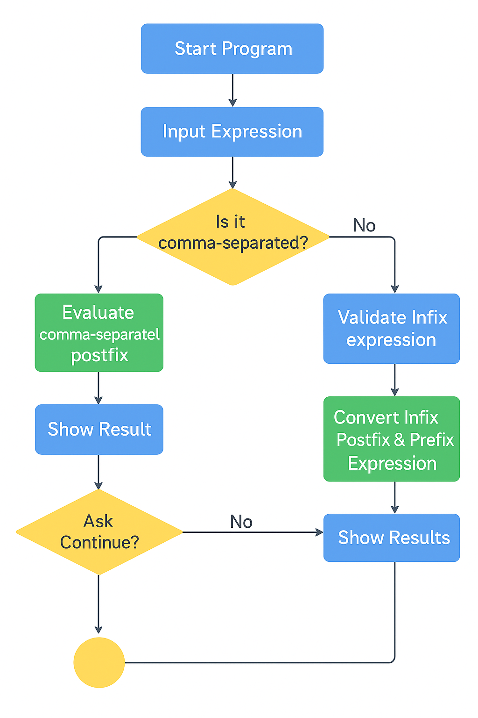
Program Flow:
Content (Flow):
1.User enters an expression
2.Detect type: comma-separated or normal infix
3.Validate input
4.Convert infix to postfix/prefix if needed
5.Evaluate expression
6.Display result
7.Ask user: continue or exit
Flowchart diagram from input → evaluation → output → repeat
Yes
Yes
Restart from Input Expression

Slide 8
Arithmetic Expressions
Infix form
operand operator operand
2+3 or
a+b
Need precedence rules
May use parentheses
4*(3+5) or
a*(b+c)

Slide 9
Evaluating Postfix Expressions
Infix Expression 6*(5+(2+3)*8+3)
Equivalent to Postfix: 6 5 2 3 + 8 * + 3 + *
Easier to be evaluated.
Could be evaluated using a stack.
Also called “Reverse Polish Notation”.
Steps:
Operands are pushed into the stack.
When an operator is encountered the last 2 operands are popped and replaced with the result.

Slide 10
Evaluating Postfix Expressions
6 5 2 3 + 8 * + 3 + *
3
2
5
6

Slide 11
Evaluating Postfix Expressions
6 5 2 3 + 8 * + 3 + *
3
2
5
6
5
5
6

Slide 12
Evaluating Postfix Expressions
6 5 2 3 + 8 * + 3 + *
8
5
5
6

Slide 13
Evaluating Postfix Expressions
6 5 2 3 + 8 * + 3 + *
8
5
5
6
40
5
6

Slide 14
Evaluating Postfix Expressions
6 5 2 3 + 8 * + 3 + *
40
5
6
45
6

Slide 15
Evaluating Postfix Expressions
6 5 2 3 + 8 * + 3 + *
3
45
6

Slide 16
Evaluating Postfix Expressions
6 5 2 3 + 8 * + 3 + *
3
45
6
48
6

Slide 17
Evaluating Postfix Expressions
6 5 2 3 + 8 * + 3 + *
48
6
288

Slide 18
Error Handling
Content:
1.Invalid characters → prompt user
2.Mismatched parentheses → prompt user
3.Division by zero → display error and retry
4.Retry until valid input is provided
5.Option to perform another operation or exit

Slide 19
Advantages
Content:
1.Flexible: multiple expression types
2.Interactive and user-friendly
3.Robust error handling
4.Easy to extend for multi-digit or variable expressions

Slide 20
Challenges
Content:
1.Handling multiple input types → solved with detection
2.Avoiding crash on invalid input → retry loops implemented
3.Managing dynamic memory → careful malloc/free usage

Slide 21
Design & Testing
Run Program: Testing

Slide 22
Conclusion
Content:
1.Program demonstrates stack & queue applications in expression evaluation
2.Supports user interaction, error checking, and continuous operation
3.Can be extended to advanced calculators or algebraic computation

Slide 23
Thank You .

